Slide 1

ITALIAN RESTAURANTS IN NEW YORK CITY

Slide 2
Introduction and Business Problem
Opening up a business in any area requires alot of research and analysis. Opening a restaurant business can be quite tricky as it requires a lot of information gathering as well as competitor analysis. Also it requires which area will be suitable for which category of cuisines.
We need to study various factors such a total population, city demographics, competitors, supply of raw ingredients, menu analysis, price analysis, over head cost and many other factors which can include fixed or variable cost. We will create and observe which area will be most suitable for current opening of restaurant as well as for future investment in NY city

Slide 3
Data Gathering
This section will cover how we will use data to solve the problem. Foursquare API have a database of over 100 million places, we will use this API to gather primary data source. This API will provide us with the ability to perform search, location sharing and details of business. Images through this API will also help in making it more interactive.
Data sources: https://cocl.us/new_york_dataset , Foursquare API
Analysis
Following are required libraries for Python.
Pandas and Numpy for data.
Foursquare API to get details.
New York City coordinates using geopy.
Map visualization using Folium

Slide 4
Methodology
Collecting New York data from https://cocl.us/new_york_dataset
Determining neighborhood popularity for restaurants
Filtering locations based on highest number of Italian restaurants
Using user rating and preference to determine which area have highest rating restaurants and how are reviews of user based on Foursquare API results
Visualizing neighborhoods based on ranking, using Folium

Slide 5
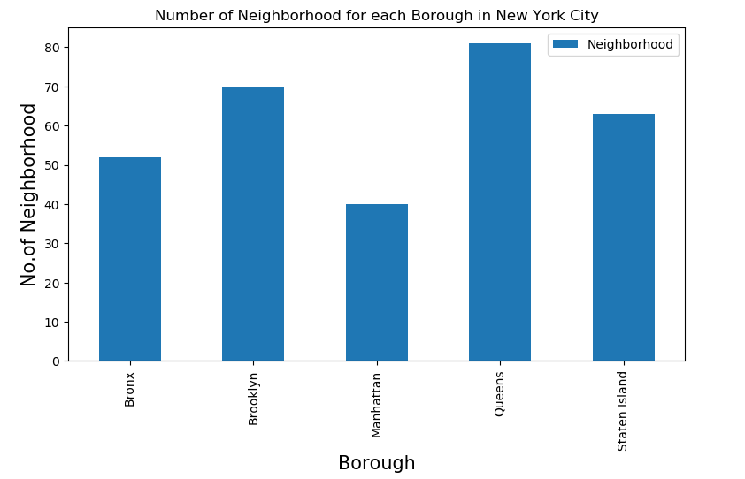
Findings
Bar chart showing Queens having highest numbers of restaurants followed by Brooklyn, Staten Island and Bronx

Slide 6
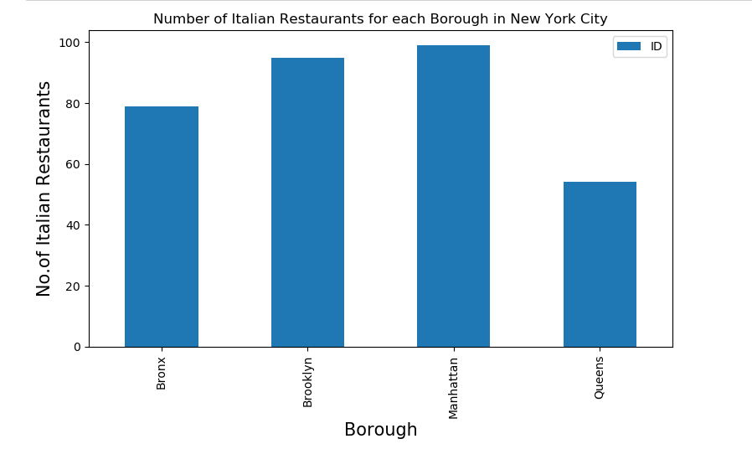
Findings
Manhattan has the highest number of Italian Restaurants, followed by Brooklyn, Bronx and Queens.

Slide 7
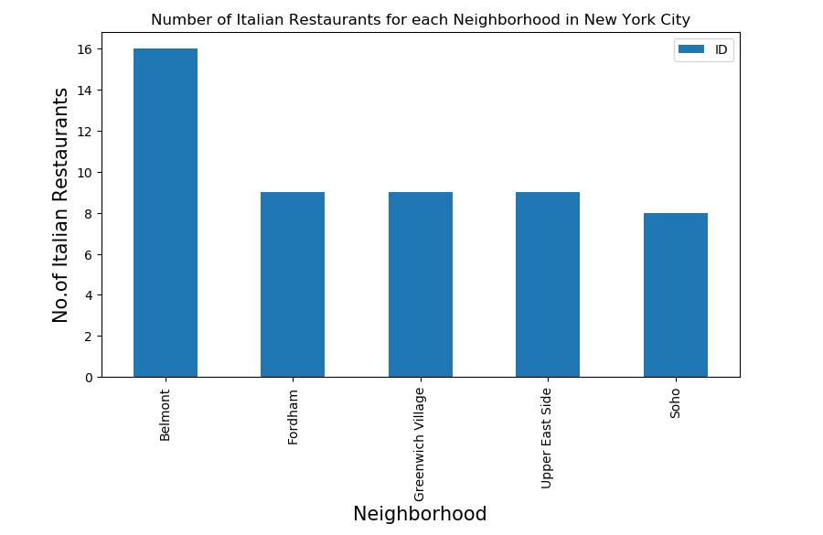
Findings
Belmont have highest number of Italian restaurants when comparing neighborhoods

Slide 8
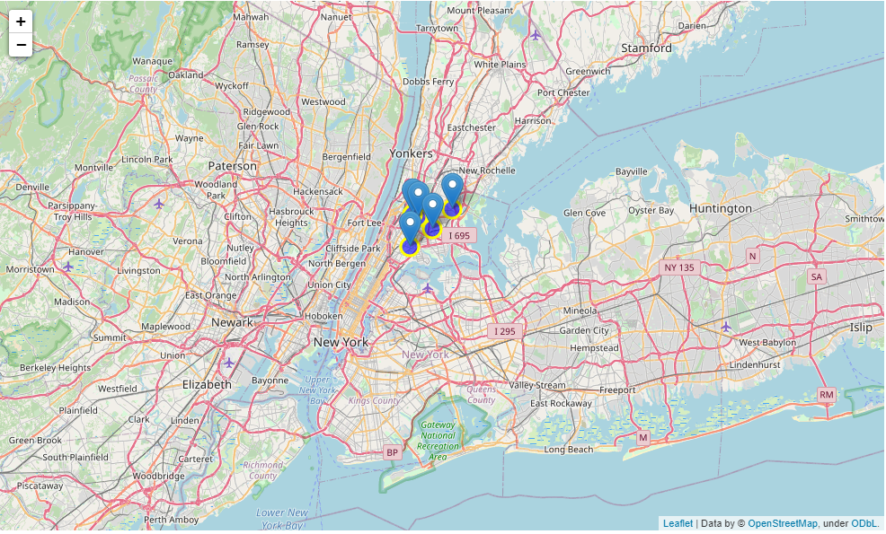
Findings
Neighborhood with highest rating of Italian Restaurants
Highlighted spots are best suitable for new restaurant.

Slide 9
Conclusion and Result
Belmont have the highest number of Italian restaurants with highest average rating.
Other neighborhood to be considered are Morrisania, Fordham and Bay Chester
Belmont have potential to open a new Italian Restaurant since average rating in this neighborhood is highest among others

